Slide 1


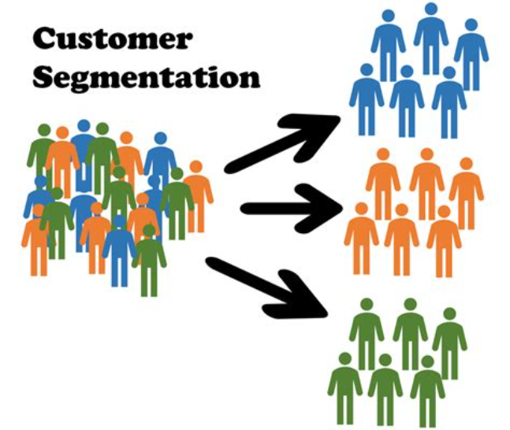
Introduction to Customer Segmentation
Customer segmentation is the process of dividing a customer base into distinct groups of individuals, organizations, or entities that share similar characteristics, needs, or behaviors. This enables businesses to better understand their customers and tailor their offerings, marketing, and strategies to meet the unique needs of each segment.

Slide 2
Clustering Algorithms
K-Means Clustering
Hierarchical Clustering
Gaussian Mixture Models (GMM)
A popular unsupervised learning algorithm that groups customers into k distinct clusters based on their similarity.
A technique that builds a hierarchy of clusters, allowing for both micro and macro-level insights.
A probabilistic model-based clustering algorithm that assumes the data is generated from a mixture of Gaussian distributions.

Slide 3
Why K means Clustering
K-Means Clustering
For customer segmentation projects,
I recommend using the K-Means Clustering algorithm.
K-Means is straightforward, computationally efficient,
and provides clear cluster assignments.
It's suitable for segmenting customers based on features like
annual income and spending behaviour, allowing businesses to
identify distinct customer groups for targeted marketing
strategies and personalized offerings.
.

Slide 4

Problem Statement and Dataset
1
Problem Statement
2
Input Attributes
3
Output Attributes
Implement customer segmentation to gain insights into a company's customer base and inform marketing strategies.
CustomerId, Age, Gender,Annual income, spending score (1-100).
Group customers into distinct clusters based on similarities in their annual income and spending behaviour.

Slide 5
Libraries and Workflow
1
Import Libraries
Load the necessary libraries for data manipulation, clustering, and visualization.
2
Load Dataset
Import the customer data into the Python environment.
3
Preprocess Data
Clean and prepare the data for clustering, including handling missing values and scaling features.

Slide 6
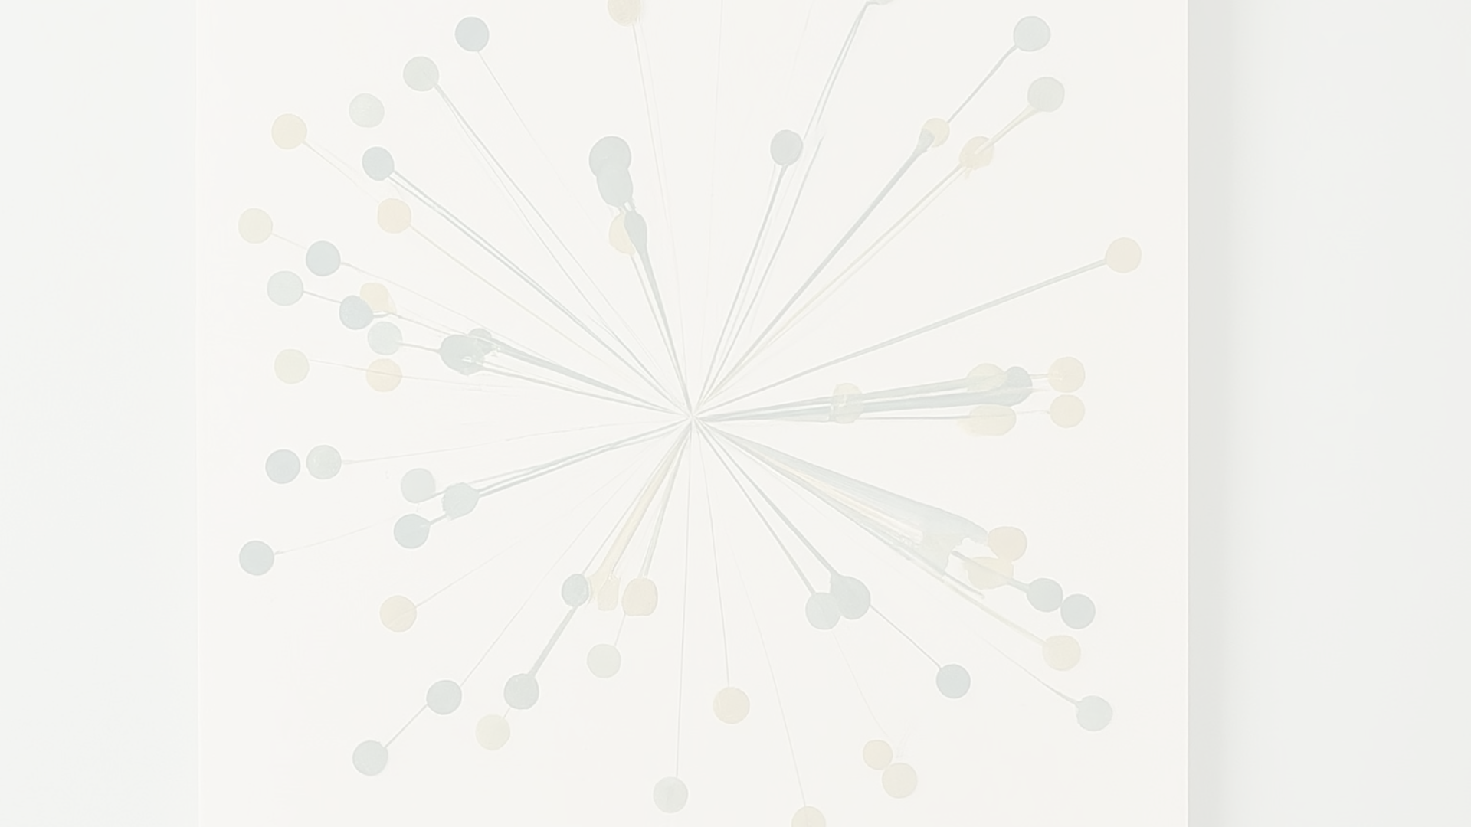
Clustering and Evaluation
Determine Optimal Clusters
1
Use the elbow method to identify the optimal number of clusters (k) in the data.
2
Train Clustering Model
Apply the chosen clustering algorithm to the prepared data.
Evaluate Performance
3
Assess the clustering quality using metrics like silhouette score.

Slide 7

K-Means Advantages and Disadvantages
Advantages
Disadvantages
Simple to implement, computationally efficient, and can handle large datasets. easy to interpret and can provide valuable insights into customer behaviour.
Sensitive to outliers, requires pre-determining the number of clusters, and may not always find the global optimum. assume clusters to be spehrical most of the times.

Slide 8


Thank You
Additional Work
I implement K – means Clustering Algorithm from Scratch to segment FIFA 22 Players based on their attributes
Name - Shruti Badjate
Roll No - BT21CSE027
Guided By- R.B. Keskar Sir

